Slide 1
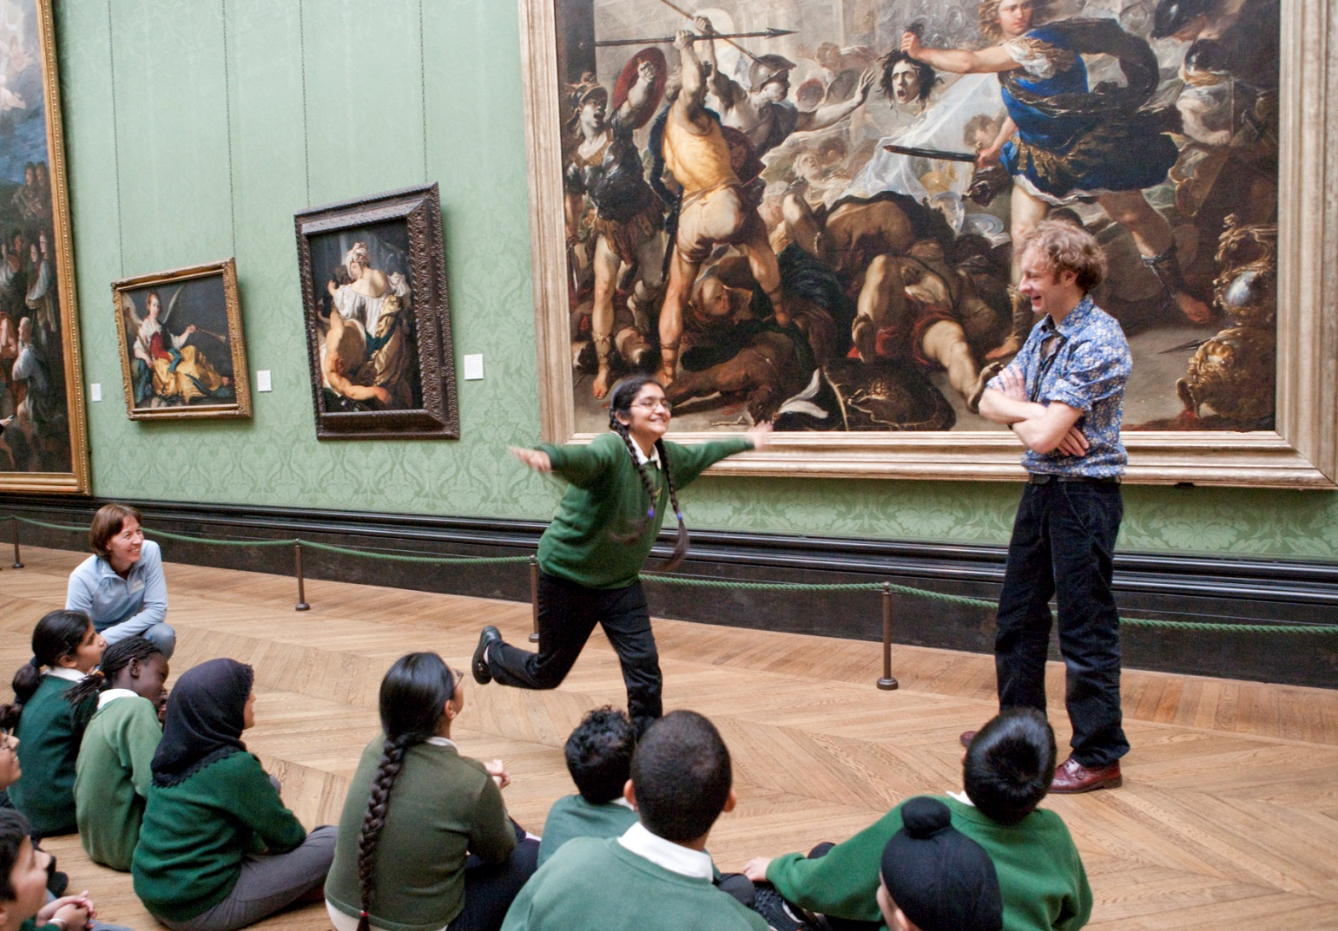
Look
Imagine
Think
Create!

Slide 2
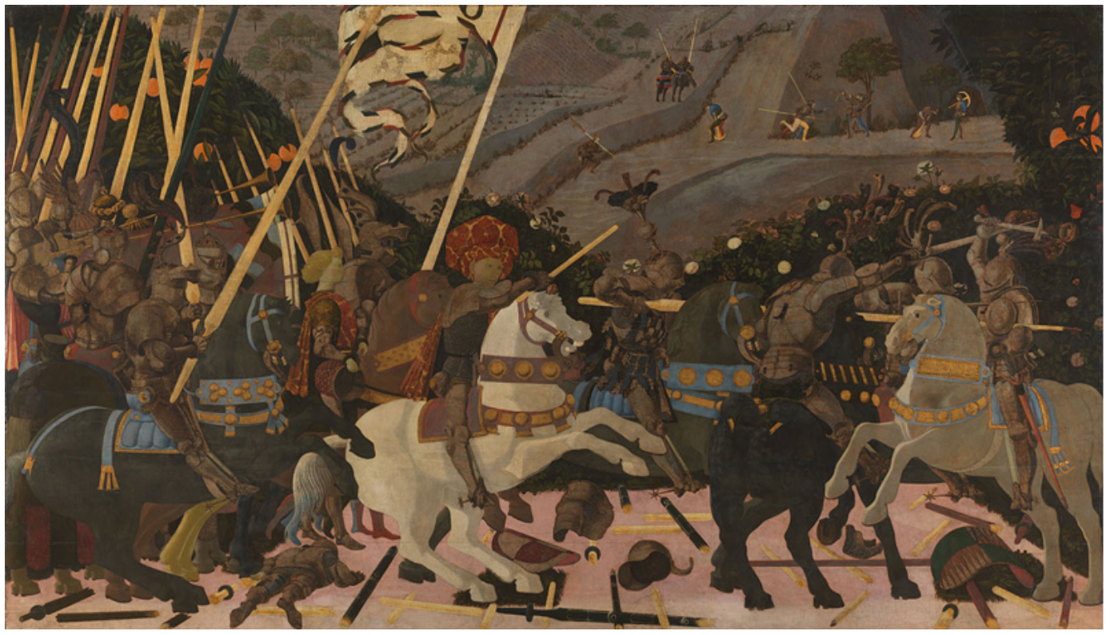
Can you remember - what is the name of the picture and who is the artist?
It is The Battle of San Romano by Paulo Uccello

Slide 3
Look at the colours in the picture
Do you like them? What words would you use to describe these colours?
Bright?
Dull?
Vivid?
Striking?
Brilliant?
Boring?
Glowing?
Subdued?

Slide 4
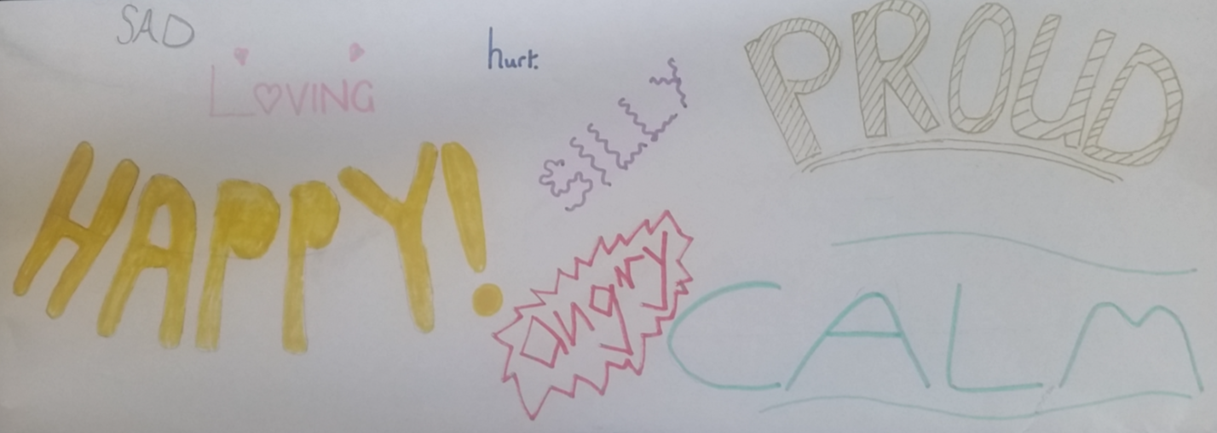
Let’s think some more about what colour means to us
Think about an emotion – maybe ‘happiness’ or ‘anger’ – what colours might you associate with these emotions? – tell someone close to you.
What colours would you use for other emotions?
Think of any emotion and write it out in any style in the colour of your choice.
Here are some emotion words to give you some ideas:
Happy hurt proud cheerful tired sad silly interested shy
frustrated angry embarrassed surprised loving anxious calm excited
Can you explain why you have chosen that colour for that emotion?

Slide 5
Look again at The Battle of San Romano and the colours that were used.
Why do you think the artist used these colours?
Actually the artist DID NOT use these colours!
WHAT? How has that happened then?
Over time the colours in the painting have faded. The grey areas in the painting (the armour, and the chainmail) would have initially been a bright SILVER but it has tarnished to a dark grey! The red (the hat, the clothes, decorative tack on the horses) would have been a bright Vermillion but it has become very dark and blackened over time

Slide 6
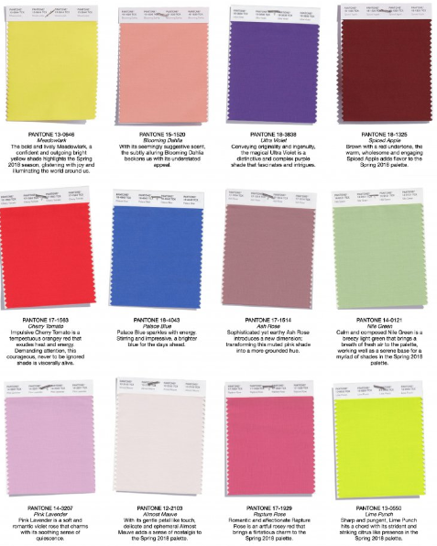
Activity 1
Let’s create a colour palette
Here is a colour palette which features ‘pantone’ colours. Each one has a number and a colour name
Pantone colors are colour codes that stand for a specific shade. You can communicate about colours by defining the pantone code. Basically, pantone is the standard language for colours.
Spring
Summer
Here are two colour palettes that have been devised for Spring and Summer
Why do you think they are different?

Slide 7
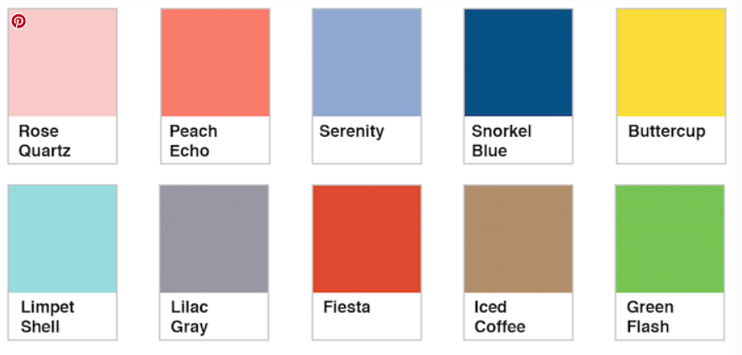
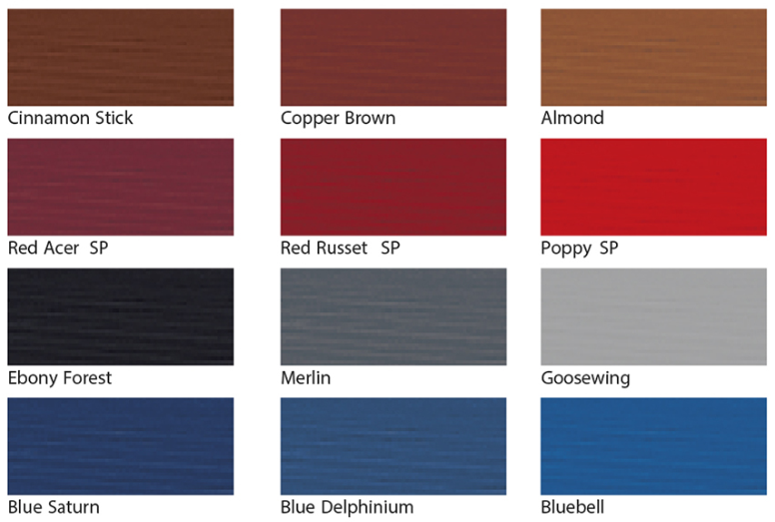
Colour manufacturers often give colours names.
They can be quite descriptive (like Primrose Yellow) or imaginative (like Island Paradise).

Slide 8
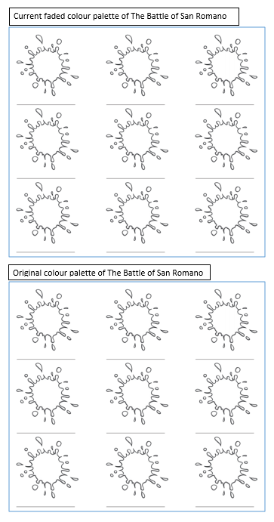
Look at the picture again. Try to create a colour palette for the picture as it CURRENTLY looks. These colours are quite dull and faded, although there are some bright colours – look at the blue on the horse tack, and the oranges.
Can you give a NAME for each of your colours – maybe Misty Grey, or Treebark Beige?
You don’t need to use just pencils, pens or paints – try using tissue paper or coloured parts from newspapers or magazines
Now create a colour palette for how the artist ORIGINALLY painted the picture,
before the colours faded. Don’t forget the colours will be much BRIGHTER!
What names will you give your new colours?

Slide 9
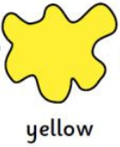
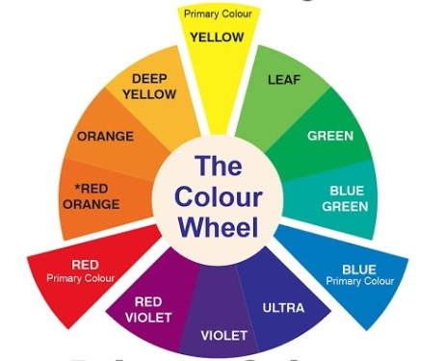
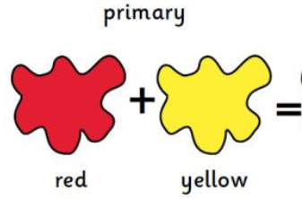
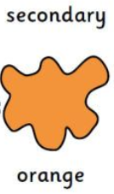
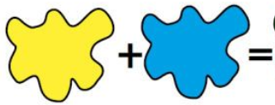
Activity 2
Let’s change our own colours!
Let’s think about how we make colours
What are the three PRIMARY colours?
What happens if we mix these PRIMARY colours together?
We can use a colour wheel to see how even more colours are made
We make SECONDARY colours

Slide 10
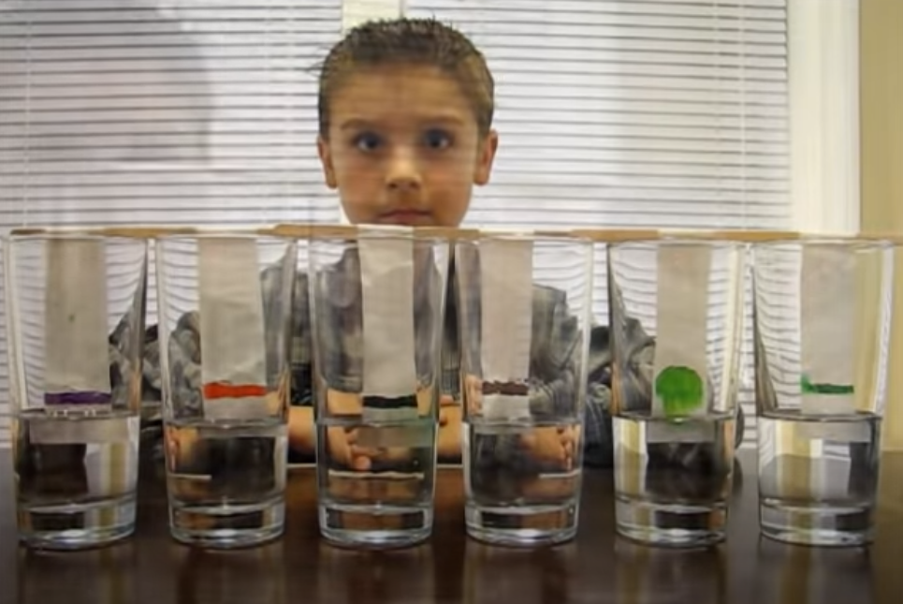
Activity 2
Let’s change our own colours!
We are going to use a process call chromatography to separate colours into their constituant parts
Chromatography is a method for separating dissolved substances from one another.
For some beautiful chromatography watch this youtube clip
For a good explanation and to see how it works watch this youtube clip
https://www.youtube.com/watch?v=RS9nPo-cfWo
https://www.youtube.com/watch?v=8uFLOQ18Mt8

Slide 11
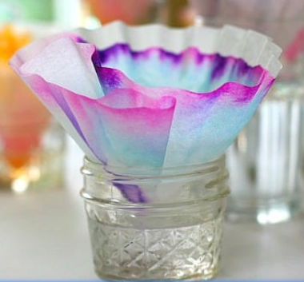
You could also mark the coffee filter in the centre, fold it and put the base into the water to see the colours spread from the centre to the edge
What You Need:
A clear glass
Coffee filters preferably but you can also use kitchen roll
Lolly stick, barbeque stick or pipe cleaner
Water
Soluble markers
Pencil
Take a coffee filter, cut it into strips large enough to fit into the glass and attach the top to a lolly stick so you can suspend the paper from the top.
Draw a coloured line about 1.5cm from the bottom of the paper with a soluble marker (generally black works well, but try different colours to see what happens)
Pour two tablespoons of water into the glass.
Place the paper in the cup so that it is suspended from the top by the lolly stick–adjust the amount of water so that the bottom of the paper just touches the water so that the water can start to soak up its length.
The colours will travel upwards on the paper!
Take the paper out, and let it dry.
What's Happening? It’s SCIENCE!
Colours are made up of molecules! The coffee filter absorbs the liquid, and the colour molecules get dissolved. Some of these colour molecules are smaller and lighter than others, so they move at different speeds. That's why the colours separate!

Slide 12
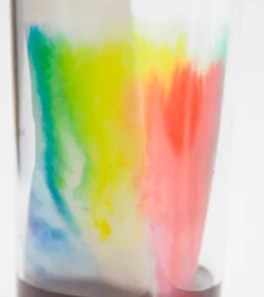
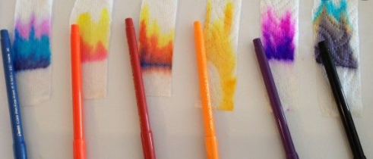
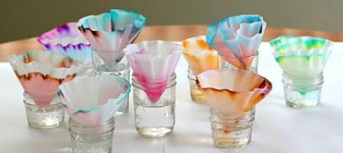
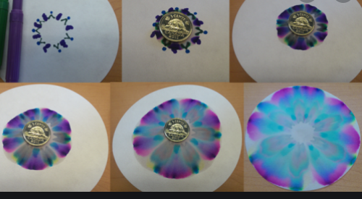
You could also try this with coloured inks or different brands of pens and see if you get different effects
Or try drawing a pattern or picture on your paper and see what happens

Slide 13
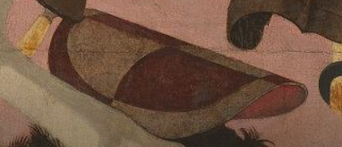
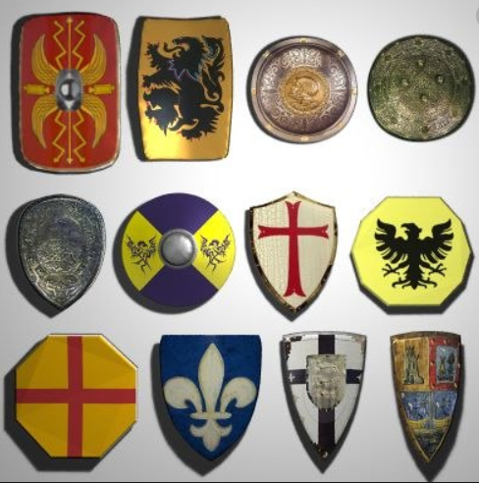
Now you have your amazing coloured paper we will use them to decorate a shield
Medieval shields were developed to shield, or protect, a knight or soldier from the direct blows from the weapons of their enemies. Shields used during the Medieval times of the Middle Ages were also used as bludgeoning (or hitting) weapons. They were sometimes decorated with coats of arms.
The shield in The Battle of San Romano is an oval shape, however you can draw yours any shape you like – use the pictures to give you ideas.
Draw your shape onto an A4 piece of paper. You may not have enough chromatography papers to decorate your whole shield but you could use them to create a centerpiece or decorate around the edge of your shield. Use your imagination! HAVE FUN!!!
Here are some examples of medieval shields – they are all different shapes and patterns.

Slide 14
Activity 3
Create your own egg tempera paint
Can you remember the name of the artist?
Yes! It was Paulo Uccello
Uccello painted this picture using a paint called egg tempera.
Egg tempera paint is a permanent, fast-drying painting medium consisting of coloured pigments mixed with a sticky material such as egg yolk!
The egg tempera technique dates back to antiquity. The Ancient Egyptians used it to paint onto stone, and Byzantine artists in Europe used the medium for their illuminated manuscripts.
ADVANTAGES OF EGG TEMPERA
Egg tempera produces glowing permanent colours, more vibrant than can be achieved with any other paint or medium.
Egg tempera has a consistency that allows for incredibly fine detail and delicate line work.
Egg tempera is opaque and bright, even over dark backgrounds.
When egg tempera is thinned with water, it becomes translucent. It is not as transparent as watercolor nor is it as opaque as gouache (opaque watercolor.) Layering brushstrokes creates gorgeous rich colours.
Egg tempera is a permanent medium after it dries. The colours should not fade (although unfortunately they did fade in The Battle of San Romano!)

Slide 15
You will need:
3 eggs 4 bowls
Chalk pastels of your choice A hammer or a pestle and mortar to grind up the pastels
A spoon (to mix together the chalk an the egg) A toothpick Some gloves (if you don’t want to touch raw egg) A few paper towels
Optional: you can add a couple of drops of vinegar to your mixture to stop it going bad (it will smell really bad if it goes off!)
You can also use tubes of watercolour or gouache paint to add to your egg instead of pastels.

Slide 16
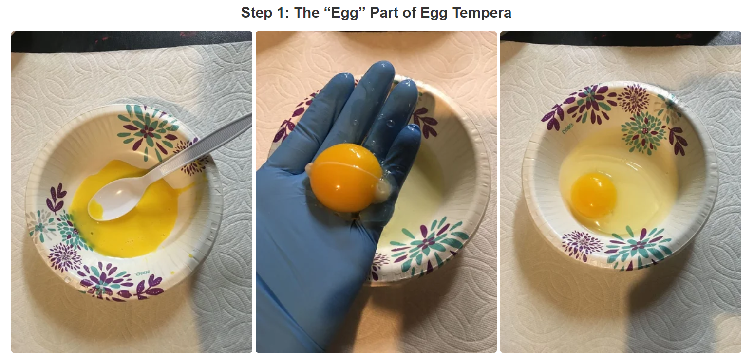
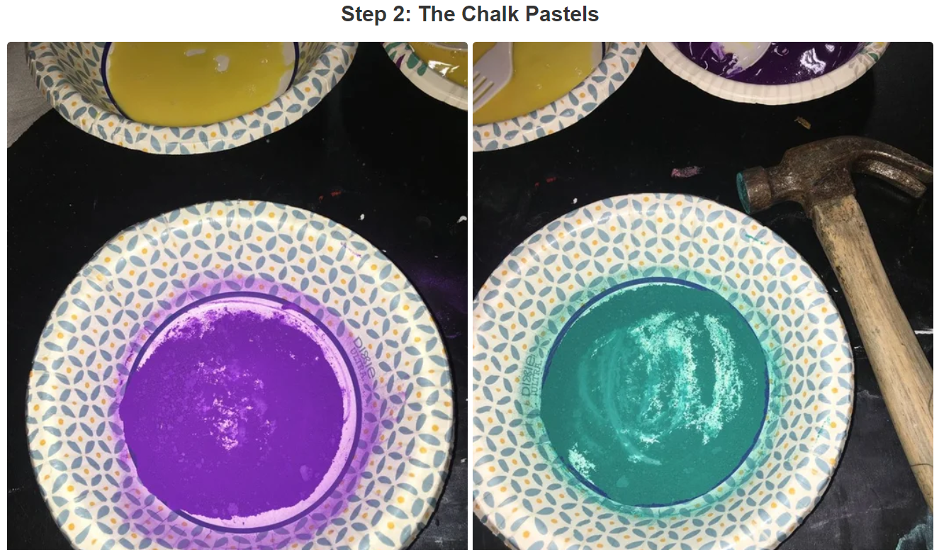
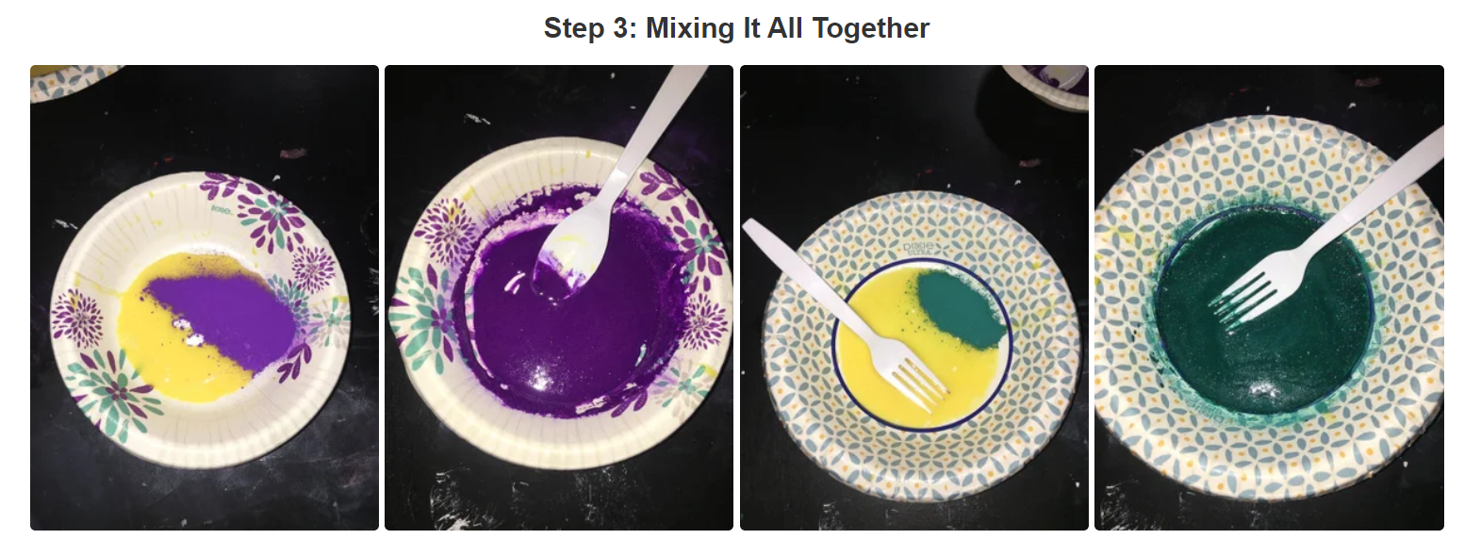
Separate the egg yolk from the egg white. Throw the egg white away. To make the paint very smooth, poke a hole in the egg yolk and then let the inside of the yolk run out. Throw the “skin” of the egg yolk away. Gently whisk the egg yolk until smooth. Repeat this step for all 3 of the eggs.
Grind up the chalk pastels using a hammer or a mortar and pestle. Grind them up until they are very smooth.
Mix together one egg yolk (the one that you prepared earlier) and one ground up chalk pastel. Mix it until it is even. Do this for all of the egg yolks.
For a slightly thinner consistency paint add a teaspoon of water and don’t forget you can add a drop of vinegar to stop the mixture going ‘off’.

Slide 17
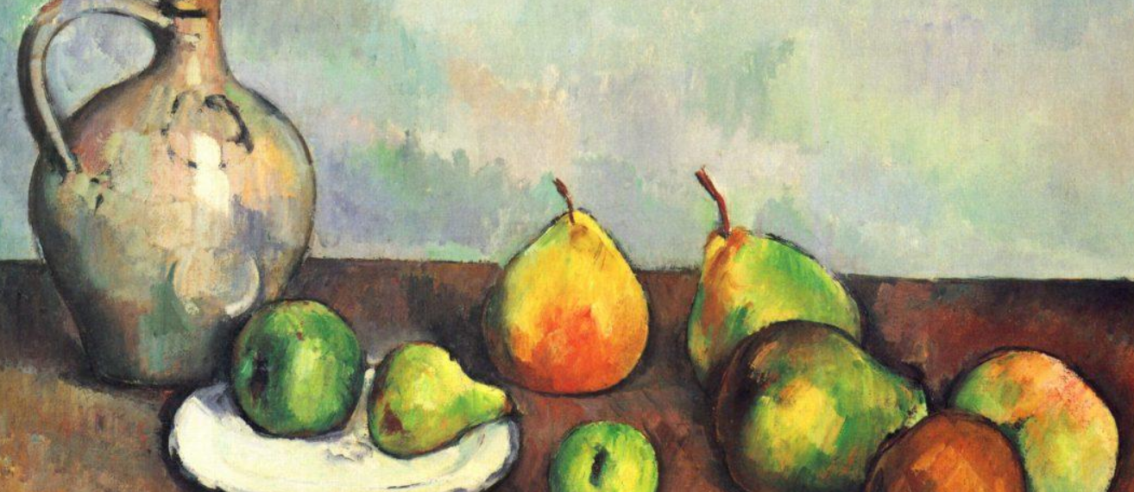
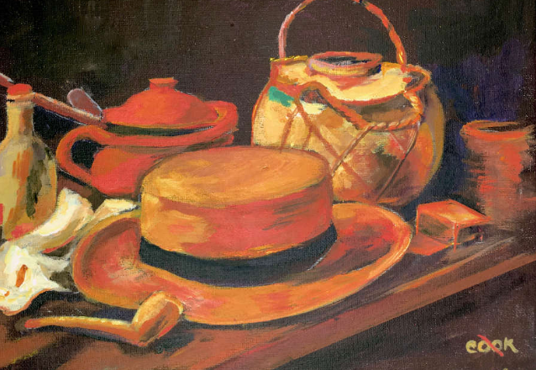
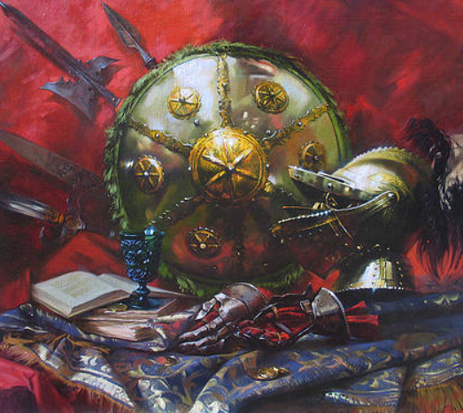
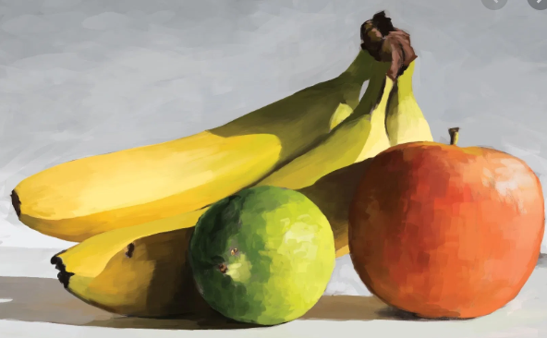
Now you can use your egg tempera paint to paint your own version of The Battle of San Romano!
Or you could use it to paint another coat of arms, a hat like the one that Nicholas de Toledo is wearing in the centre of the picture, or a still life of fruit such as oranges and pomegranates (which are also featured in the painting).
Please remember to send in your finished works of art to:
info@eliotbank.lewisham.sch.uk
Let’s
Create!

