Slide 1
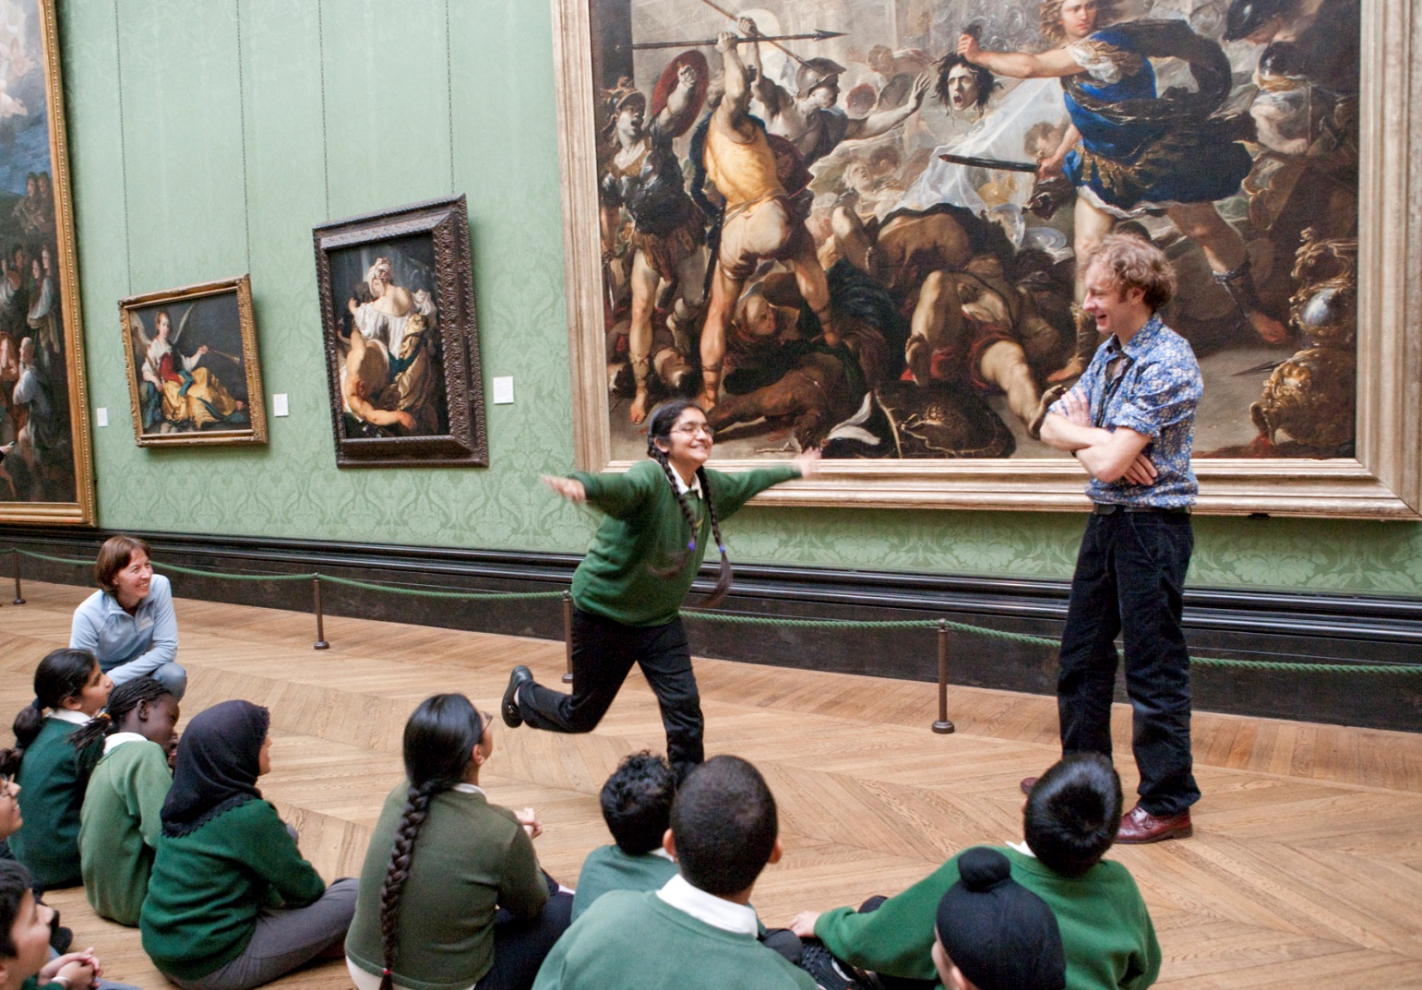
Look
Imagine
Think
Create!

Slide 2
Let’s have another look at
The Battle of San Romano
Can you remember who the artist was?

Slide 3
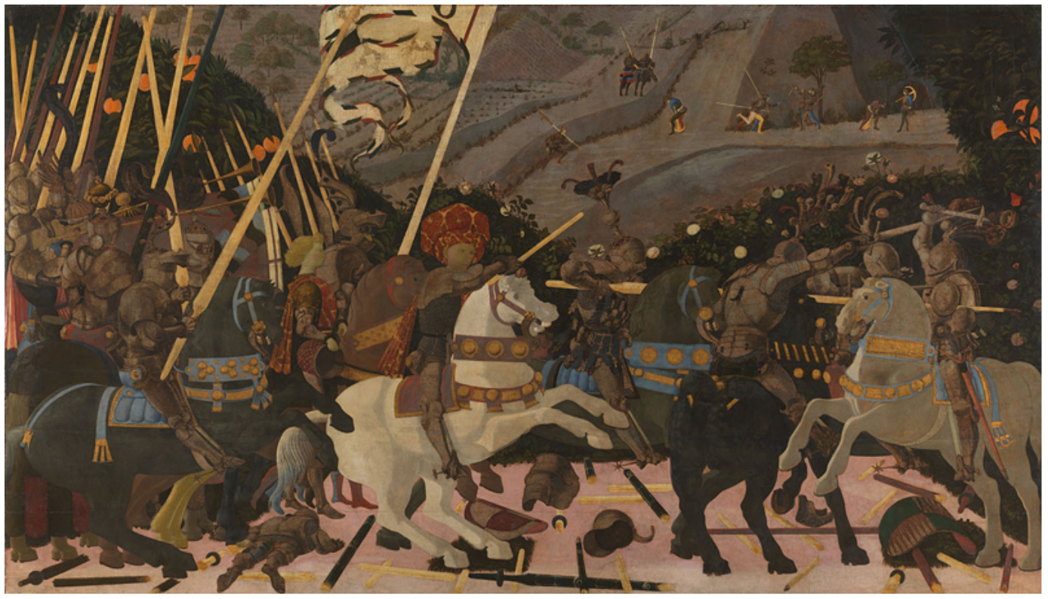
That’s right - the artist was Paolo Uccello

Slide 4
Let’s recap – what is the picture about?
Talk to someone close to you – what can you remember about this picture?
Who were the two sides battling?
Where did the battle take place?
What were they fighting about?
Who won?
This painting shows a battle between the troops of Florence and Siena in Italy.
The city of Florence wanted to control a wider area so it went to war with a city on the coast, Lucca, so that it could be in a better position to do trade. But Lucca had allies (friendly cities who had agreed to help defend it) – Siena, Pisa and Milan - who then threatened to surround Florence and cut it off from the coast completely. So Florence went to war with Siena and, thanks to reinforcements arriving late in the day, Florence won.

Slide 5
Let’s look at the items they are using for battle
What items can you see that would only be used in a battle?
Write down as many as you can spot
banners (flags)
lances (pole for jousting)
ceremonial trumpet
helmet
armour
shield
other weapons:
hammer
What is the purpose of each of these things? Why would they be used in a battle?

Slide 6
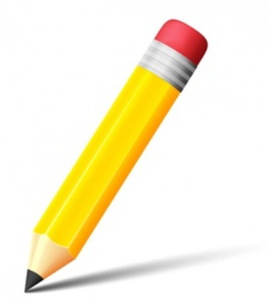
There is a large version of the picture on the next page
Let’s sketch!
We are going to try some quick sketches of this picture to get to know it even better.
Look at this picture for 2 minutes. At the end of this time you are going to try to sketch the picture – you will only have 3 minutes to do as much as you can. Don’t worry that this is a short period of time – we are not expecting you to draw all the detail – just the main parts. Which part will you focus on? The foreground? The horses? The man in the centre (remember his name is Niccolò da Tolentino)?

Slide 7
For an extra challenge try sketching without taking your pencil off the paper!
Just look for 2 minutes
Click for 2 min timer
Now sketch for 3 minutes
Click for 3 min timer

Slide 8
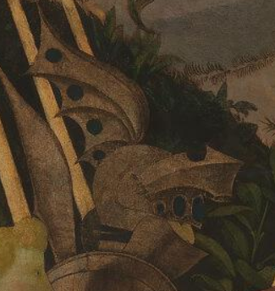
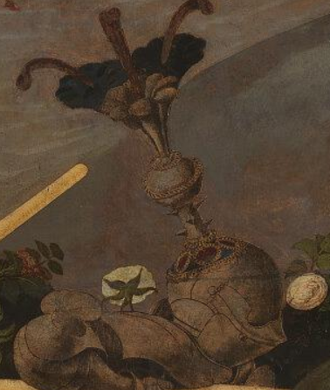
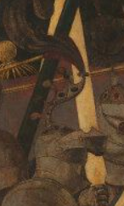
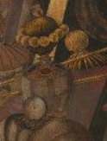
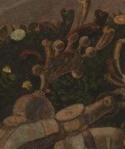
Look at the helmets in Battle of San Romano in more detail
Aren’t these helmets fancy?
Do you think all the helmets in the actual battle would have been so decorative?

Slide 9
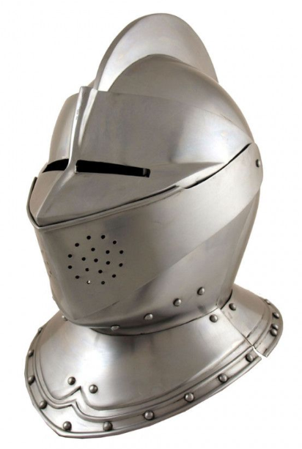
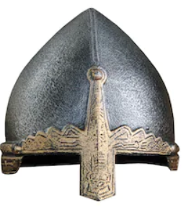
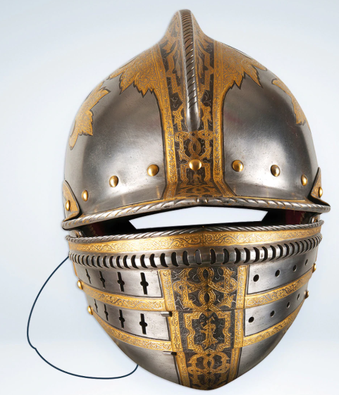
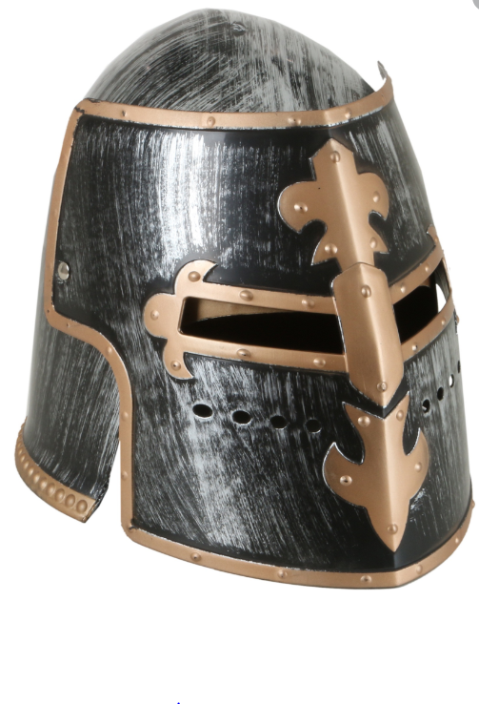
Here are examples of other medieval helmets
What does a helmet need to do to be effective?
It needs to protect its wearer
If you had to go into battle which of these helmets would you wear and why? Tell someone close to you
Would you like to wear one of these?
Would it be comfortable?
Do you think you could easily see your enemy?

Slide 10
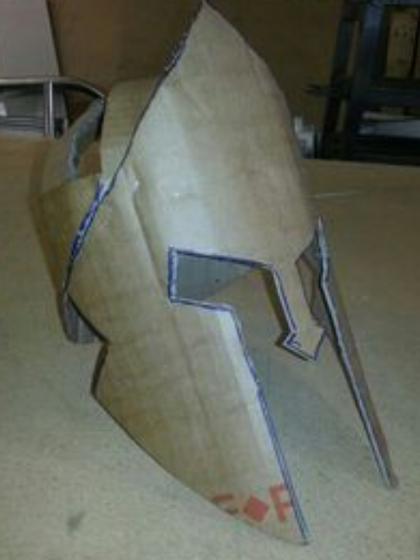
Activity 1
make your own BATTLE helmet
You will need lots of cardboard, some glue, tape or staples, a piece of string.
Cut a long, wide strip of cardboard. Wrap it around your head just above your eyes and mark where
it starts to overlap. This is your headband. Cut it a little longer than this length, then tape or staple it
so it fits your head size.
Take 2 narrower strips of cardboard. Tape/ staple the first one to the front of the headband . Put the head band on your head then wrap the narrow strip of cardboard across the top of your head to the back and mark where it starts to overlap the headband and tape/ staple it to the headband. Do the same with the second band going from ear to ear. The two narrow strips should form a cross and this gives you the basis for your helmet.
Using a large piece of cardboard, about A4 size, mark out the front of your helmet – you will need to make sure that you leave some spaces for eyes and that you have a central nose piece and covering for the rest of your face. Mark the centre line down the middle of your piece of cardboard. Take a piece of string then carefully take it from the outside edge of your right eye to the outside edge of your left eye – this is the eye width - you can mark this on your cardboard. Draw in the gaps for your eye spaces and then mark where your nose and cheek protectors will go. (You can design your own or use the template on the next page to help you). Glue, staple or tape this facemask to your headband.
You can use your imagination to add extra details and make the helmet your own – look at the helmets in the picture of Battle of San Romano for inspiration. You could use more cardboard, feathers, textiles etc. Maybe use recycled materials.
How will you decorate your helmet? – you could wrap it with aluminium foil for a metal effect, paint it or even collage from newspaper or magazines cut up into small pieces. Have fun!!!

Slide 11
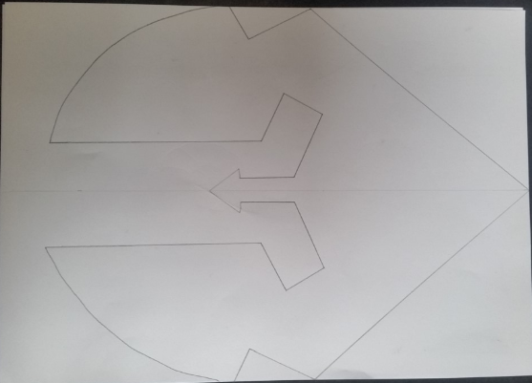

Slide 12
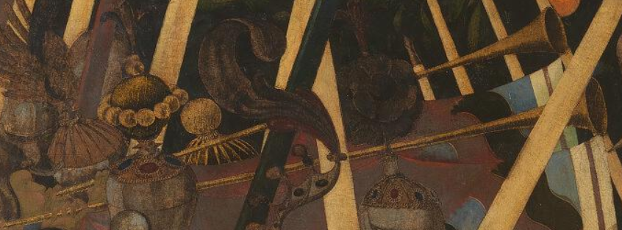
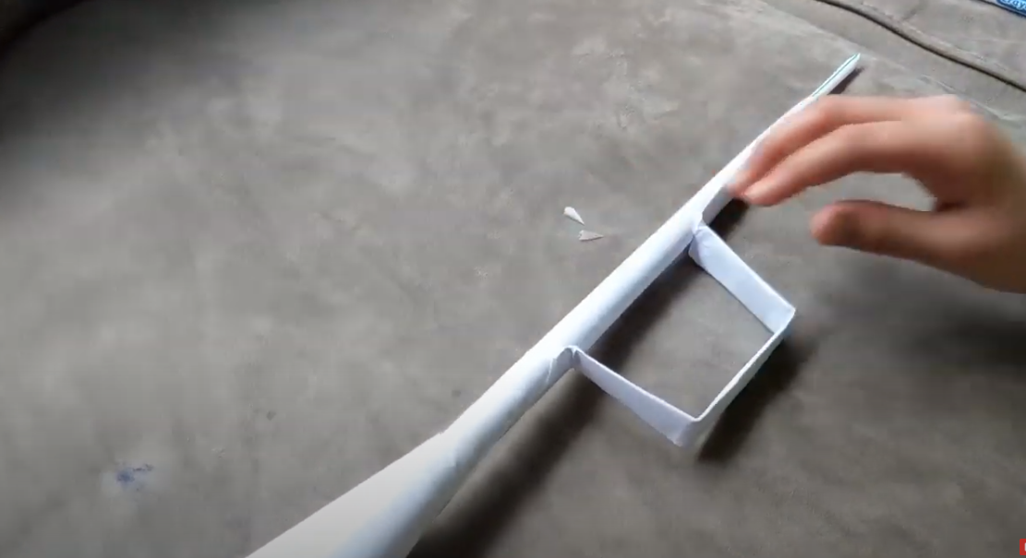
Activity 2
make a trumpet
You will need:
2 pieces of A4 paper/ thin card
A round pencil or felt tip pen to roll the paper around
Sellotape
A drinking straw
Starting at a corner roll one piece of paper around the felt tip pen, remove
the pen and secure with a piece of tape.
Cut the second piece of paper in half then roll one half around the pen , remove the pen and secure with a piece of tape. Flatten this tube then fold into thirds. Bend the ends backwards so that you get this shape.
This is your trumpet’s handle
Wrap the other half of your halved paper around your index finger to make a cone shape and fasten with tape. Attach this to one end of your long thin roll of paper. Take your trumpet handle and attach halfway along your trumpet.
With your drinking straw cut a piece diagonally from the end and slide into the thin end of your trumpet. Seal it well with tape without any gap to hold the straw.
Now you can decorate and blow your trumpet!
Watch this fun video to help you
https://www.youtube.com/watch?v=1N6DWqb2d-I

Slide 13
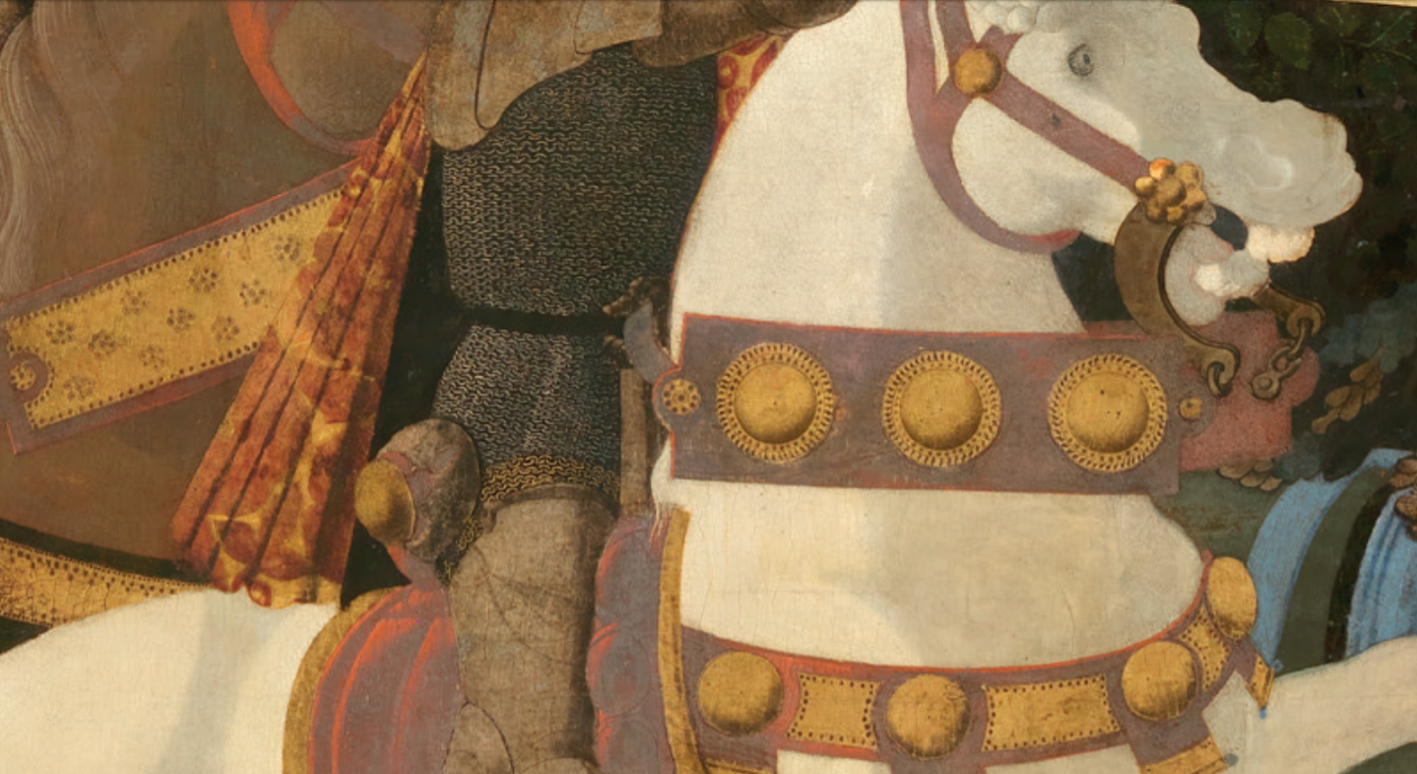
But it is not just the soldiers who have fancy battle ornaments – let’s look at the horses!
The horses are wearing golden horse tack - tack is equipment or accessories put on horses such as saddles, stirrups, bridles, halters, reins, bits, harnesses, and breastplates

Slide 14
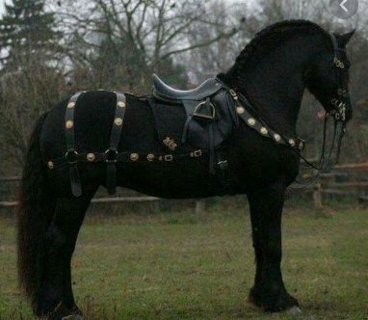
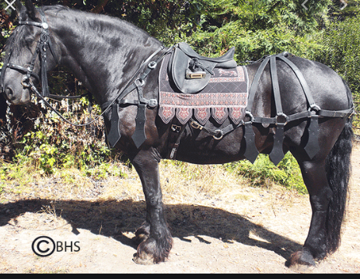
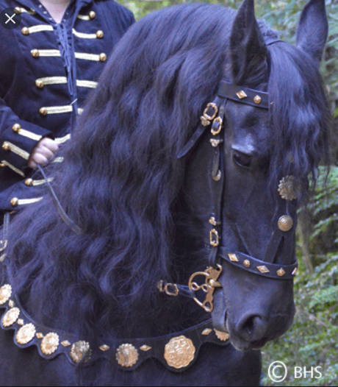
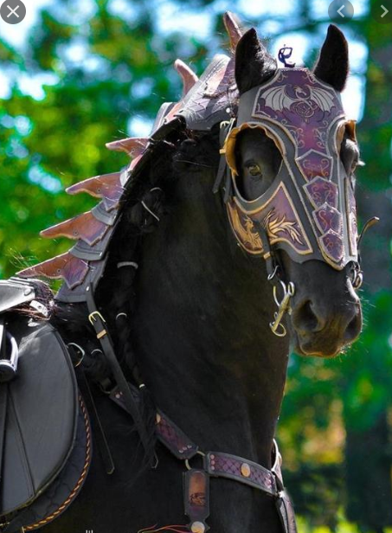
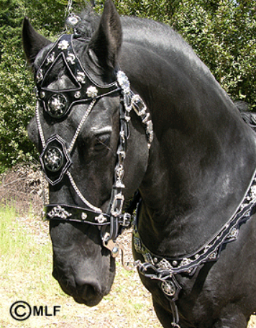
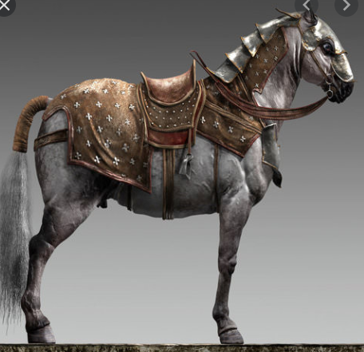
Look at all the different types of decorative horse tack that was used in medieval times. Which do you think were more practical in protecting the horses?

Slide 15
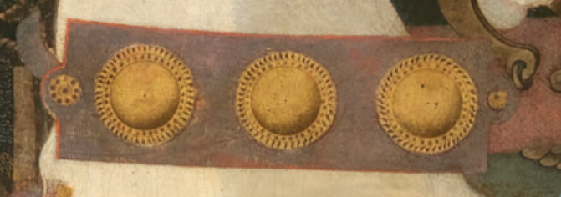
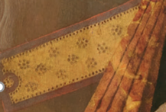
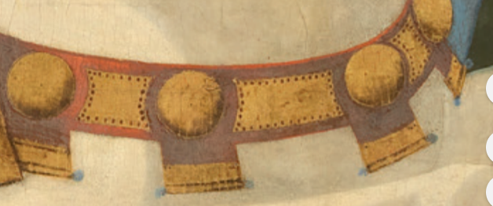
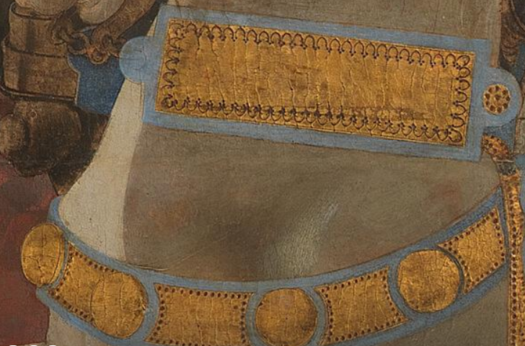
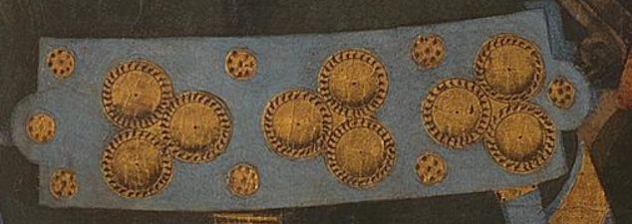
Look at the detail on the horse tack in The Battle of San Romano.

Slide 16
Activity 3
make some decorative horse tack
You will need:
A piece of paper 30cm x 4cm
A piece of aluminium kitchen foil about 30cm x30cm
Blunt pencil
On your piece of paper design your own horse tack
Fold your foil in half and then half again and then in half again, so that you have a strip of foil which is 8 layers thick. The more layers you have the deeper your embossing can be.
Now put your foil on top of an exercise book or a newspaper so that it is on a soft base. Take your pencil and copy your design onto foil to make your own horse tack, pressing quite hard so that you emboss your pattern but not so hard that you tear the foil.
You do not have to stick with a rectangle – you could use squares or draw circles and pad them out with more foil underneath. Use your imagination and have fun!

